Slide 1


Introduction to Two-Factor Authentication
Two-factor authentication (2FA) is a security enhancement that requires users to provide two different forms of identification to verify their identity when logging into an account or accessing sensitive information. This additional layer of security helps protect against unauthorized access, even if a password is compromised.

Slide 2

SMS-based Two-Factor Authentication
How it Works
With SMS-based 2FA, the user provides their phone number when setting up the account. When they try to log in, the service sends a one-time code via text message to that phone number, which the user must enter to complete the login process.
Advantages
SMS 2FA is a widely adopted and convenient method, as most people already have access to a mobile phone. It provides an additional layer of security beyond just a password.
Limitations
SMS messages can be intercepted, and the user's phone could be lost or stolen, compromising the 2FA. Some advanced attacks can also target the SMS infrastructure itself.

Slide 3
Authenticator App-based Two-Factor Authentication
How it Works
Advantages
Limitations
Authenticator apps generate a one-time code that changes at regular intervals, usually every 30 seconds. Users must enter this code, in addition to their password, to log in. The app and the service being accessed use a shared secret to generate matching codes.
Authenticator apps are more secure than SMS, as they do not rely on the phone network. They also work even without a cellular or internet connection, making them more reliable.
Users must set up the app and have access to their device to generate the code. If the device is lost or stolen, the user may be locked out of their accounts until they can recover the app.

Slide 4

Hardware Security Key-based Two-Factor Authentication
1
How it Works
Hardware security keys are small USB or Bluetooth-enabled devices that users must physically plug in or tap to their device to complete the login process. They generate a unique code that is validated by the service being accessed.
2
Advantages
Security keys offer the highest level of protection, as they are resistant to phishing and other attacks that can compromise SMS or app-based 2FA. They also don't rely on a phone or internet connection.
3
Limitations
Users must carry the physical security key with them, and they can be lost or stolen like any other physical item. Integration with services may also be more complex than other 2FA methods.

Slide 5

Biometric Two-Factor Authentication
How it Works
Biometric 2FA uses unique physical or behavioral characteristics, such as fingerprints, facial recognition, or iris scans, to verify a user's identity. These biometric identifiers are compared to the user's pre-stored profile to confirm their identity.
Advantages
Biometric 2FA is highly secure, as these identifiers are difficult to forge or replicate. It also provides a seamless user experience, as the authentication process can be performed quickly and without the need to remember a separate code or carry a physical device.
Limitations
Biometric data can be compromised if a user's device is lost or stolen, and there are privacy concerns around the storage and use of biometric information. Some users may also be uncomfortable with the invasive nature of biometric authentication.

Slide 6
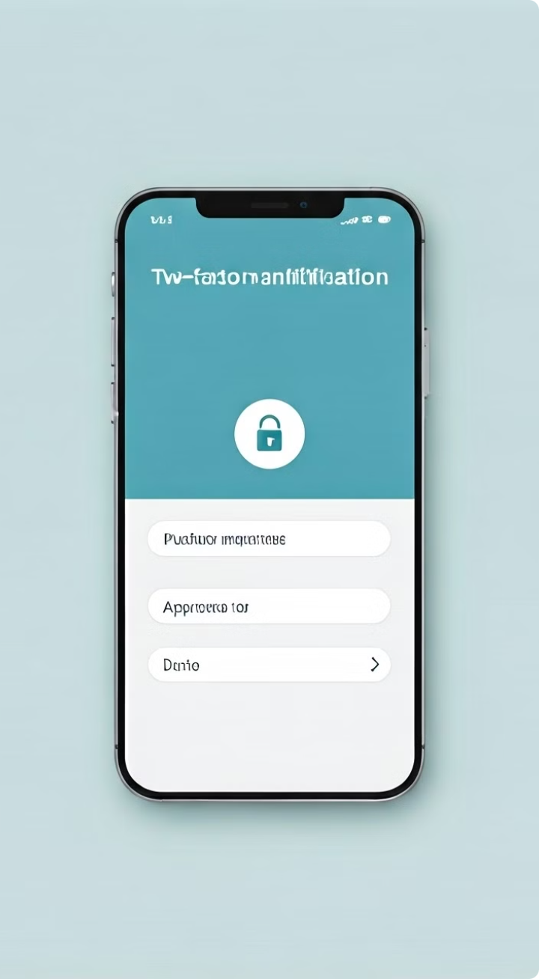





Push Notification-based Two-Factor Authentication
Convenient
Push notifications are a user-friendly way to authenticate, as they don't require the user to remember or enter a code.
Secure
Push notifications can be secured with biometrics, like fingerprint or face ID, for an extra layer of protection.
Reliable
Push notifications work even without a cellular or internet connection, as long as the device has power.
Limitations
Push notifications rely on the user's device, which could be lost, stolen, or compromised, potentially allowing unauthorized access.

Slide 7
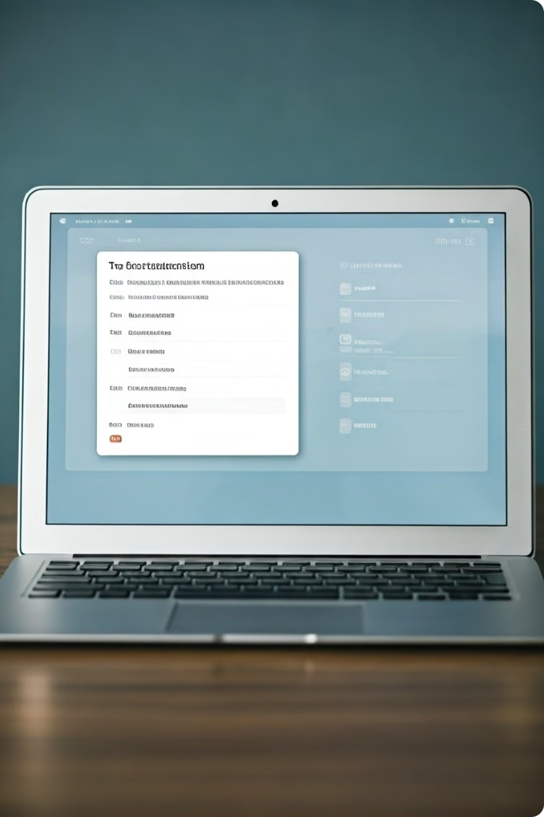



Email-based Two-Factor Authentication
Log In Attempt
When a user tries to log in, the service sends a one-time code to the user's registered email address.
Check Email
The user must then check their email and enter the code to complete the login process.
Secure Access
This additional step helps ensure that only the legitimate account owner can access the service.

Slide 8
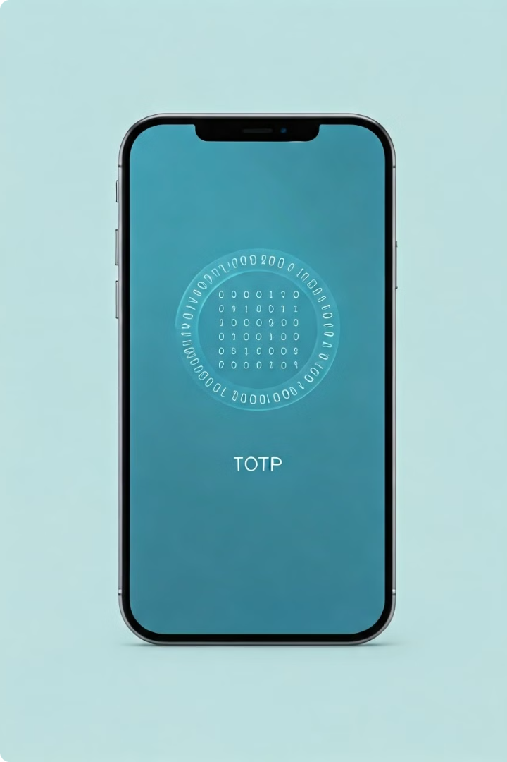
TOTP (Time-based One-Time Password) Two-Factor Authentication
1
Shared Secret
TOTP 2FA uses a shared secret key between the service and the user's authentication app or device to generate a one-time password.
2
Time-based Code
The one-time password changes at regular intervals (usually 30 seconds), providing an additional layer of security beyond just a static password.
3
Secure Login
The user must enter the current TOTP code, in addition to their password, to log in and access the service.

Slide 9

Advantages of Two-Factor Authentication
1
Improved Security
2FA significantly reduces the risk of unauthorized access, even if a password is compromised.
2
Convenient User Experience
Many 2FA methods, like biometrics and push notifications, provide a seamless authentication process.
3
Compliance and Regulatory Requirements
2FA is often required or recommended by industry standards and regulations to protect sensitive data and systems.
4
Reduced Fraud and Identity Theft
The additional layer of verification makes it much harder for attackers to gain access to user accounts.

Slide 10

Conclusion and Considerations
Two-factor authentication is a powerful tool for enhancing account security and protecting against unauthorized access. While each 2FA method has its own advantages and limitations, organizations and individuals should carefully evaluate their options and choose the approach that best fits their security requirements and user needs. Ongoing education and awareness are also crucial to ensure that 2FA is properly implemented and utilized to maximize its benefits.

